Slide 1

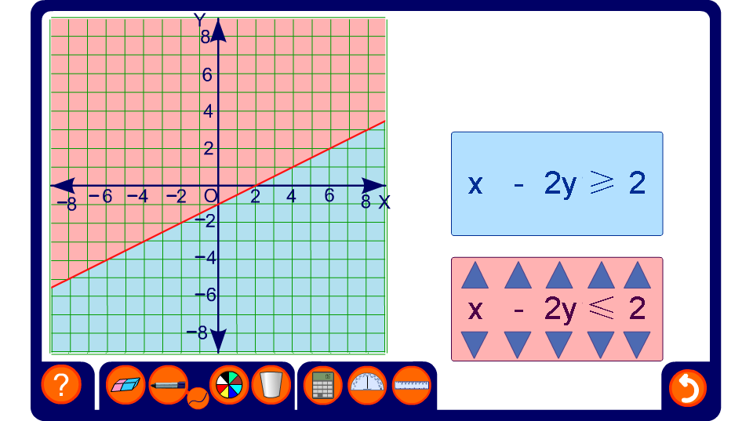


Inequalities in two variables

Slide 2
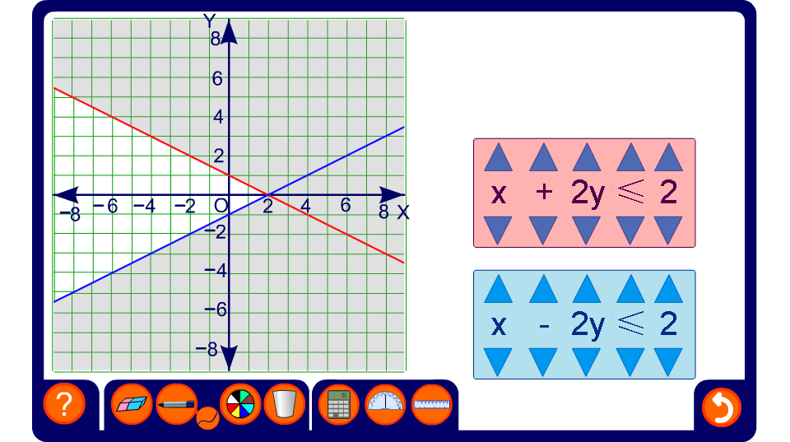
Combining inequalities in two variables 1
Notes:
This activity demonstrates the effect of combining two inequalities.

Slide 3
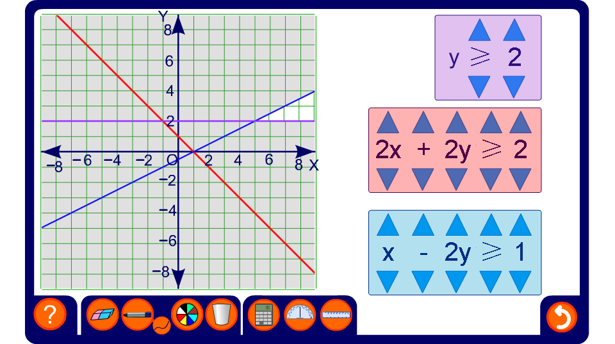
Combining inequalities in two variables 2
Notes:
This activity demonstrates the effect of combining three inequalities.

